Slide 1
EE 701-ROBOT VISION
Moving Object Detection in Infrared Imagery
by
Salim Sırtkaya & Tuba M. Bayık

Slide 2
Outline
Infrared Properties
Motion
Algorithm for tracking moving objects
Visualization of the Algorithm
Final Words
Demo

Slide 3
Infrared Properties
IR imagery smoothes out object edges and corners
Moving objects often appear brighter than the background
IR images are noisy and have less contrast
IR sequences are not easily available
Demand more robust (less noise sensitive) techniques than visual sequences

Slide 4
Motion
Motion information can be a very strong aid for finding objects in images as many biological vision systems indicate
There are four possibilities for the dynamic nature of the camera and world setup:
    Stationary camera, stationary objects (SCSO)
    Stationary camera, moving objects (SCMO)
    Moving camera, stationary objects (MCSO)
    Moving camera, moving objects (MCMO)

Slide 5
Algorithm
Grab the
Background
Image
Create
difference
picture
TRACKING
Threshold
Remove
unlikely
regions
Find object
center

Slide 6
Algorithm
Grab the
Background
Image
The background scene is grabbed for further processing. The scene must be stationary.
User intervention is required.
Create
difference
picture
TRACKING
Threshold
Remove
unlikely
regions
Find object
center

Slide 7
Algorithm
Grab the
Background
Image
Create
difference
picture
Compare the present frame with the background pixel by pixel to detect changes
TRACKING
Threshold
Remove
unlikely
regions
Find object
center

Slide 8
Algorithm
Binarizes the difference picture according to the rule :
D_{jk}(x,y) = 1 if |F(x,y,j)-F(x,y,k)|>T
0 otherwise
The threshold T is selected in different ways.
One way is to select a global threshold.
Another way is to use an entropy based thresholding method like ‘Entropy-Yen’
In this method, entropic correlation is utilized:
C(T)=C_{b} (T)+C_{f} (T)
=-log [ Σ₀^{T} (p(g)/P(T))² ] - log [ Σ₀^{T} (p(g)/P(T))² ]
T_{opt}=arg max { C(T) }
Grab the
Background
Image
Create
difference
picture
TRACKING
Threshold
Remove
unlikely
regions
Find object
center

Slide 9
Algorithm
Grab the
Background
Image
Create
difference
picture
The results of thresholding is quite noisy, especially in highly cluttered background.
To remove the regions that are unlikely to be object parts, we use morphological operators. Dilation and erosion are used one after another to remove the noise and recover back all the object parts.
Size filter is also used after morphological operators to decrease the false alarm rates.
TRACKING
Threshold
Remove
unlikely
regions
Find object
center

Slide 10
Algorithm
Grab the
Background
Image
Create
difference
picture
TRACKING
Threshold
Remove
unlikely
regions
After the steps above, the object is left. To locate the target mark, object center is calculated.
Find object
center

Slide 11
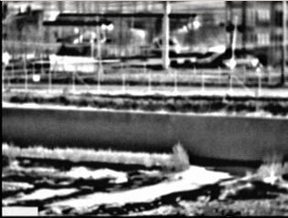
Visualization of the Algorithm
Grab the
Background
Image
Create
difference
picture
TRACKING
Threshold
Remove
unlikely
regions
Find object
center

Slide 12
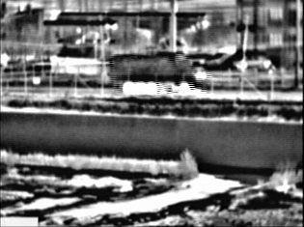
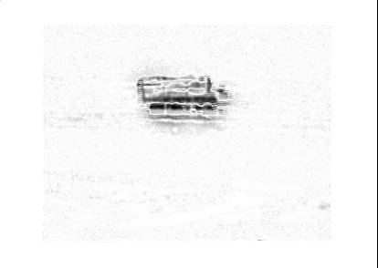
Visualization of the Algorithm
Grab the
Background
Image
Create
difference
picture
TRACKING
Threshold
Remove
unlikely
regions
Find object
center

Slide 13
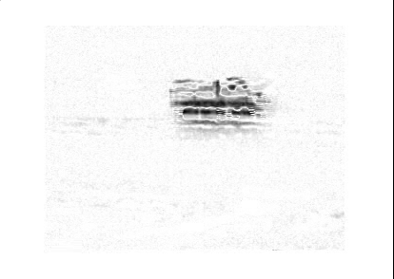
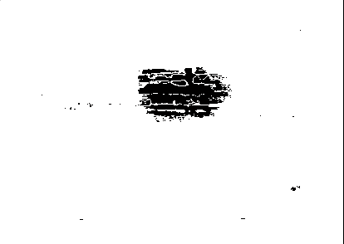
Visualization of the Algorithm
Grab the
Background
Image
Create
difference
picture
TRACKING
Threshold
Remove
unlikely
regions
Find object
center

Slide 14
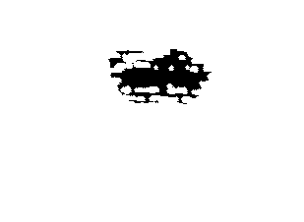
Visualization of the Algorithm
Grab the
Background
Image
Create
difference
picture
TRACKING
Threshold
Remove
unlikely
regions
Find object
center

Slide 15
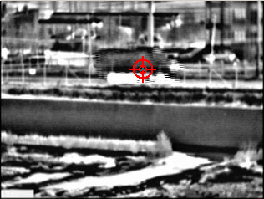
Visualization of the Algorithm
Grab the
Background
Image
Create
difference
picture
TRACKING
Threshold
Remove
unlikely
regions
Find object
center

Slide 16
Final Words
Moving object detection using difference pictures,thresholding and morphology was studied.
False alarm rate is small in global thresholding and when there is no misalignment between frames.
  Global Thresholding can be used only in one particular aspect, so adaptive thresholding should be used.
  The misalignment between frames is due to small camera motions. This can be eliminated by
      Differencing images according to their intensity characteristics
      Robust Multi-Scale Affine Registration

